Slide 1
Analyzing Tutoring Dialogue Transcripts Project Update
Nikhil Patel
nikhilp@andrew.cmu.edu

Slide 2
Big Goal: Encourage Tutors to Use Given Tutoring Strategies
1. Giving Effective Praise (Desired and undesired)
2. Reacting to Errors (Desired and undesired)
3. Determining what students know (Desired and undesired)
4. Helping Students Manage Inequity (Desired and undesired)
5. Responding to Negative Self-Talk (Desired and undesired)
Strategies are from PLUS Tutors Platform

Slide 3
These tutoring strategies encourage students to persevere and increase their engagement
Praise:
“Good job! You’re a genius!” X
“Great job on solving that math problem. You persevered through solving by using a new math concept” ✔
Responding to Negative Self-Talk:
“I’m so stupid” -> “You’re not good at this yet, everybody learns at their own pace!” ✔

Slide 4
The efficacy of these strategies are backed by Personalized Learning Squared (PLUS), a human-AI math tutoring initiative
PLUS is led by CMU’s Human Computer Interaction Institute, and partnered with Carnegie Learning and Stanford University
Goal is to double math learning gains for 10,000 middle school students by 2027, especially those from low-income families.
Research indicates the efficacy of the aforementioned tutoring strategies

Slide 5
Our Specific Application: Annotating Chatroom Tutoring Transcripts for Effective Strategy use
Our Dataset is The Teacher-Student Chatroom Corpus,
One-to-one English lessons in an Online Chatroom
Corpus Released in 2022, contains 262 total conversations
Already annotated for certain sequence types (i.e. scaffolding)

Slide 6
We want to create an easy to use platform for tutors to learn from their previous tutoring sessions
Megan Gu has been working on the frontend for the platform (see her talk from July 31st)
By allowing tutors to see where they’ve applied tutoring strategies correctly and where they’ve neglected to use strategies, we aim to help tutors increase their strategy-usage.

Slide 7
Data Annotation

Slide 8
Annotation of the Dataset Involved 4 annotators, and we annotated a total of 25 conversations
5 datasets were annotated at a time
Annotators were Megan Gu, Jahnvi Shah, Claire Liu, and myself

Slide 9
Annotation Scheme Details (Optional)
-1: Tutoring Strategy is not applicable (i.e. student utterances)
0: Tutoring Strategy was applicable but wasn’t used by the tutor
1: Tutoring Strategy was applicable and was used by the tutor

Slide 10
We annotated in batches to ensure annotation consistency, and held group sessions to mitigate inconsistencies
After every batch, Fleiss scores were calculated and the 4 annotators did sessions where we went over entries we disagreed on
We made rules for how to deal with certain cases, and where to draw the line for certain strategies
Drawbacks:
Fleiss Kappa was used to identify which strategies we needed to work on (however, Fleiss Kappa sensitive to class imbalances)
Requires an extensive, 4-person review session, taking away independent ratings

Slide 11
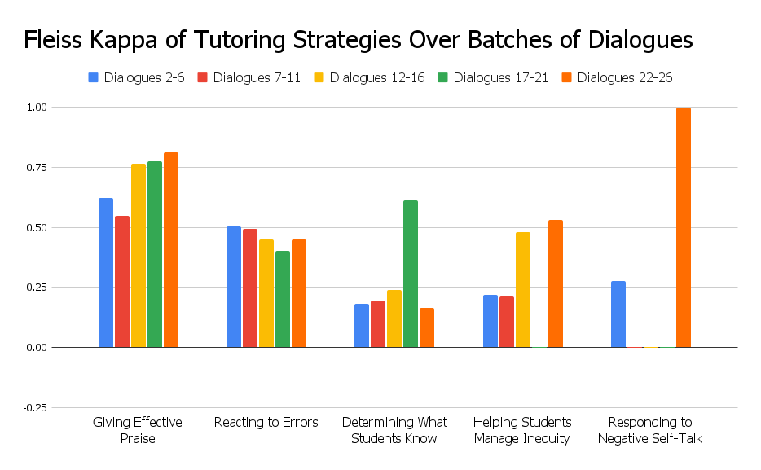
Fleiss’s Kappa shows mixed trends, but this is likely due to the Kappa’s inability to handle class imbalances
Ideally, Fleiss Kappa would increase from left to right for each strategy, indicating better annotator agreement over time.
Group annotation sessions mitigate this annotation disagreement

Slide 12
Model Selection

Slide 13
We are considering GPT-3.5 prompting methods in order to implement an LLM-based strategy evaluator
Base Methods:
Few Shot Prompting
Few Shot Chain-of-Thought Prompting
Zero Shot Prompting
Zero Shot Chain-of-Thought

Slide 14
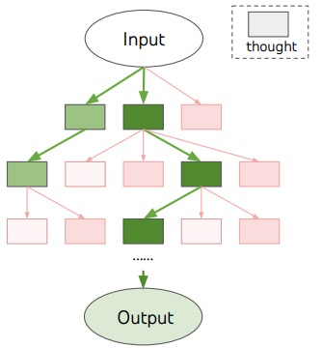
Other Future Prompting Techniques: Tree of Thoughts
Generalizes Chain of Thought Prompting
Allows Language Models (LMs) to consider multiple reasoning paths, and then evaluate and follow the most promising paths (using search algorithms like Depth or Breadth first search)

Slide 15
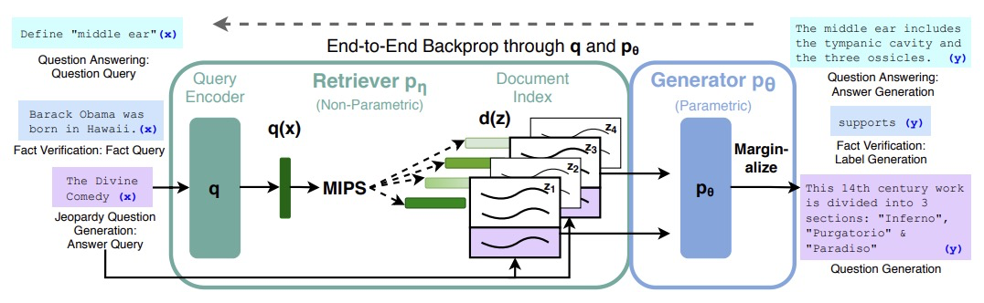
Other Future Prompting Techniques: Retrieval Augmented Generation (RAG)
RAG uses a pretrained neural retriever to index documents, allowing for the Large Language Model to perform better on knowledge-intensive tasks
For more information, see Jeri Rao’s talk from May 29th

Slide 16
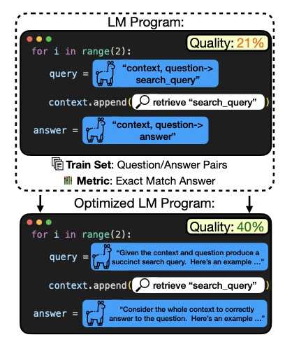
Other Future Prompting Techniques: Prompt Optimization (DSPy)
DSPy factorizes the problem into optimizing instructions and their few-shot demonstrations
They use several strategies including a surrogate model to evaluate instructions and meta-optimization procedures.
13% improvement on common tasks on Llama3-8B

Slide 17
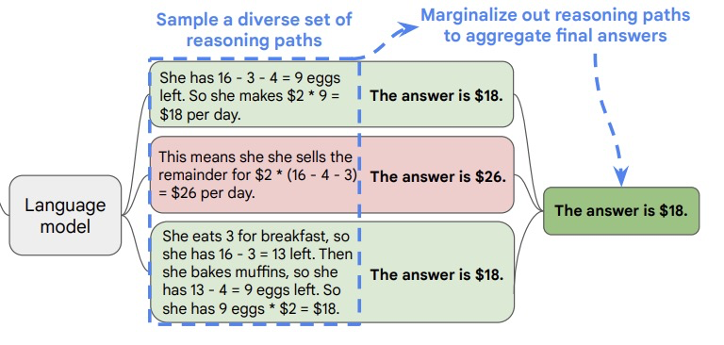
Potential Prompting/Evaluation Technique: Self-Consistency
Samples a diverse set of reasoning paths, and selects the most consistent answer, accounting for the sampled reasoning paths.
Boosts arithmetic and commonsense reasoning benchmarks by up to 18%

Slide 18
Thank you to Megan Gu, Jahnvi Shah, and Claire Liu!
The four of us have been working on annotation and model selection over the course of the summer.

Slide 19
References
Caines, Andrew, et al. "The teacher-student chatroom corpus version 2: more lessons, new annotation, automatic detection of sequence shifts." Swedish Language Technology Conference and NLP4CALL. 2022.
Falotico, Rosa, and Piero Quatto. "Fleiss’ kappa statistic without paradoxes." Quality & Quantity 49 (2015): 463-470.
Lewis, Patrick, et al. "Retrieval-augmented generation for knowledge-intensive nlp tasks." Advances in Neural Information Processing Systems 33 (2020): 9459-9474.
Opsahl-Ong, Krista, et al. "Optimizing Instructions and Demonstrations for Multi-Stage Language Model Programs." arXiv preprint arXiv:2406.11695 (2024).
Thomas, Danielle, et al. "When the tutor becomes the student: Design and evaluation of efficient scenario-based lessons for tutors." LAK23: 13th International Learning Analytics and Knowledge Conference. 2023.
Yao, Shunyu, et al. "Tree of thoughts: Deliberate problem solving with large language models." Advances in Neural Information Processing Systems 36 (2024).

